Slide 1
AiEnergy_USST
Dr. Yongbao Chen
DATE:2023.02.20

Slide 2
Overview
1
Competition Introduction
2
Methodology
3
Results and Discussion
4
Conclusions and Future Work

Slide 3


Team information
Dr. Yongbao Chen is currently a Lecturer at the University of Shanghai for Science and Technology (USST). He earned a PhD in civil engineering, focusing on energy modeling and optimal control of buildings and energy systems, from Tongji University in 2020. His research interests include Machine learning, big data analytics and AI for smart energy-efficient systems. He has published more than 18+ SCI papers in Applied Energy, Energy, etc., and the citations are over 1000+ (Google scholar). He won 5+ big data competition title from 2021.
Mr. Zhe Chen is currently a second-year PhD student in the Department of Building Environment and Energy Engineering at the Hong Kong Polytechnic University (PolyU). He obtained his master's degree from Tongji University in 2020. His research interests include building big-data analytics, data-driven building energy efficiency and flexibility. He has published more than 10 journal papers in Advances in Applied Energy, Sustainable Cities and Society, etc., and his h-index is 9 (Google Scholar). He won the silver prize in Global AI Challenge for Building E&M Facilities as the team leader in 2021.
Notes:
具备大赛经验
优秀的队友

Slide 4
0
1
Competition Introduction

Slide 5
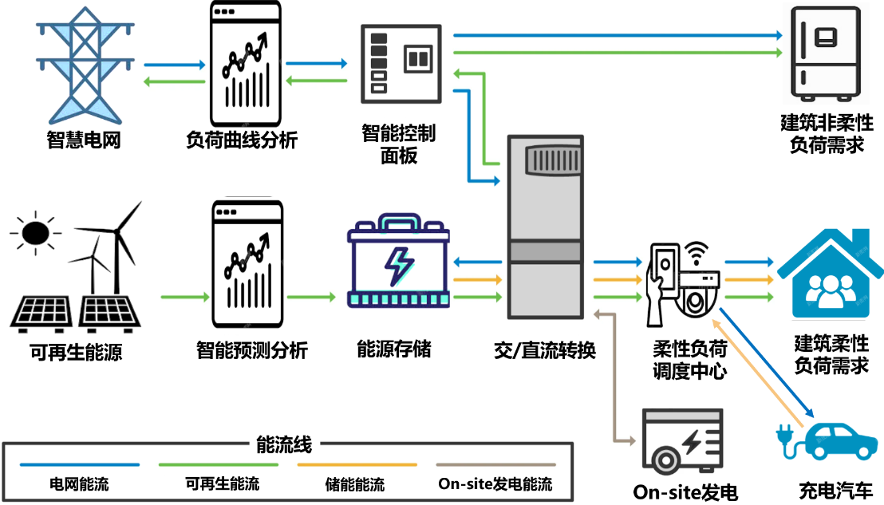
Background
In an electric system, users are distributed geographically. We need to schedule electric energy for each user to store the energy locally, supporting the real-time demand of the user. With the development of techniques for renewable energy, users can deploy renewable devices to support their electric demand and reduce the requirement and cost of buying traditional electric energy from the smart grid. We propose the problem of predicting the generated renewable energy to support the optimal deployment of the distributed energy storage system.
Load forecasting is important
Demand-supply coordinated control energy system
Notes:
1、供需协同控制，源网荷储控制的基础
2、供给侧预测，还有需求侧预测

Slide 6
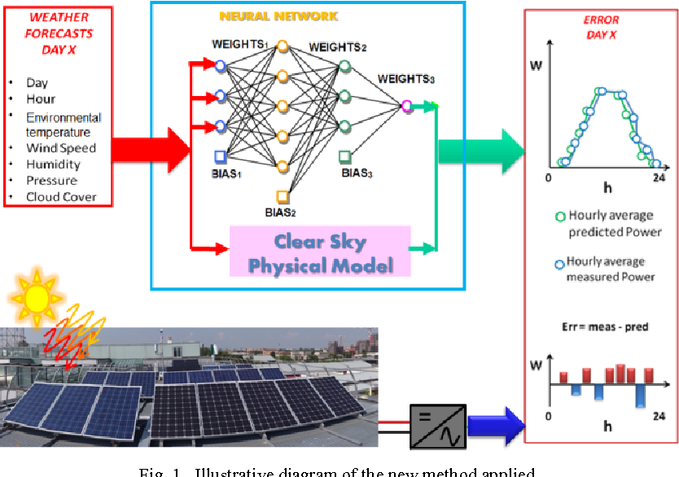
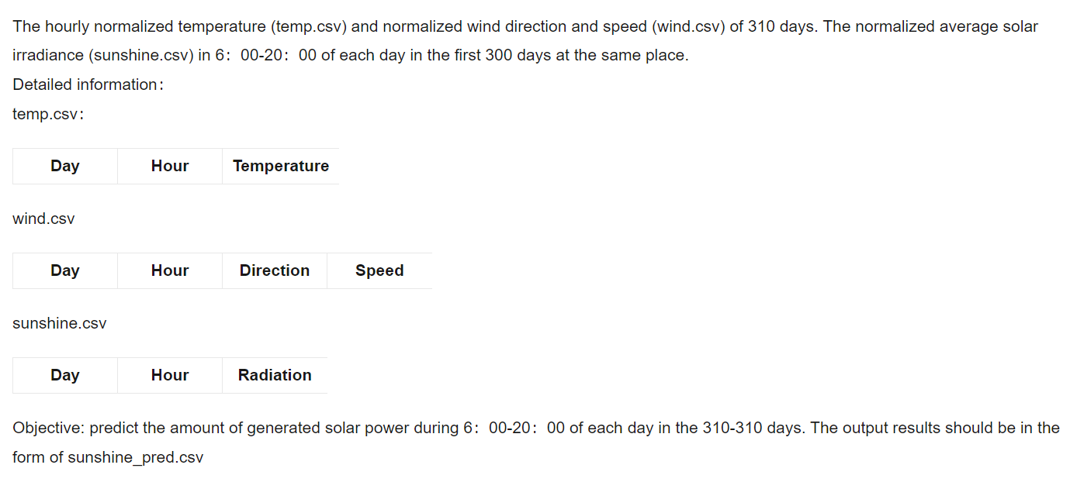
Competition task
Given a user's average daily electric demand and the historical environmental data related to solar generating, the task is to predict the amount of generated solar energy.
LightGBM
Preliminary round
Final stage
Notes:
1、feature engineering
2、algorithm selection
3、parameters tuning

Slide 7
0
2
Methodology

Slide 8
Original data analysis
The hourly normalized temperature (temp.csv), wind direction and normalized speed (wind.csv), and the normalized average solar irradiance (sunshine.csv) in 6：00-20：00 of each day for 300 days.
Objective is to predict the amount of generated solar power (i.e., solar irradiance) during 6：00-20：00 in the future 10 days.
Notes:
1、数据量少，数据质量高

Slide 9
Original data analysis
The normalized average solar irradiance (sunshine.csv) in 6：00-20：00 of each day for 300 days.

Slide 10
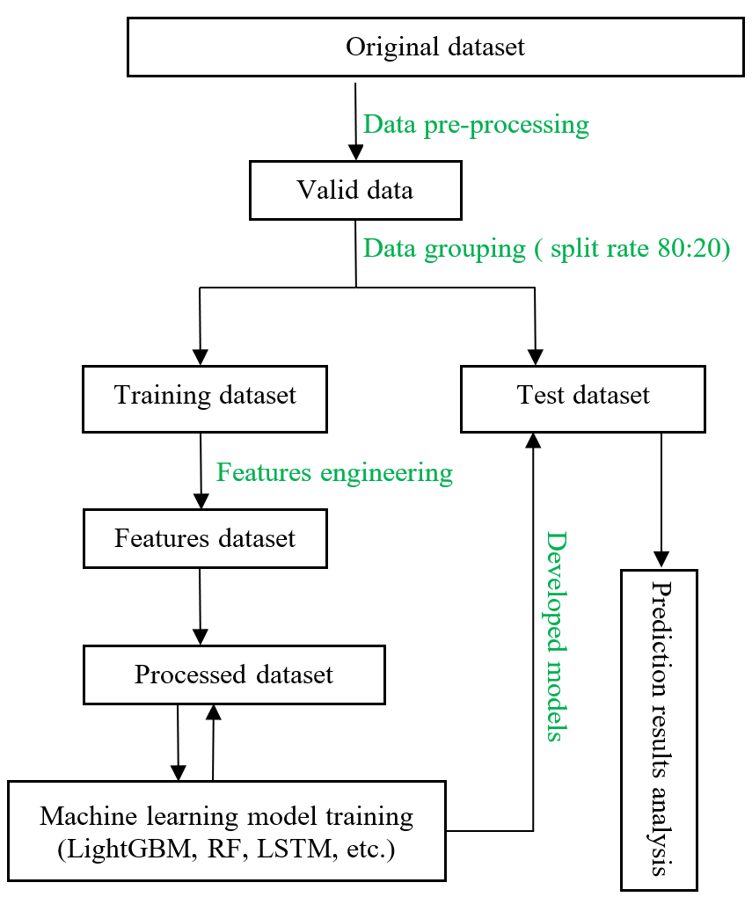
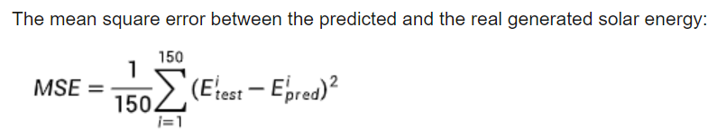
Methods and algorithms selection
Input features: Wind speed, wind direction, temperature, shifting features, labels (0,1, generated feature, 0 represents low solar output day, 1 represents high solar output day.
Output feature: Solar irradiance
Selected algorithms: LightGBM, Random Forest (RF), ElasticNet, Lasso, XGBoost, SVR, LSTM.
Method: stand-alone algorithms, boosting and stacking method.
Evaluation index:
Notes:
1、24*3+1+3=76 input features
2、Lightgbm is the best algorithm

Slide 11
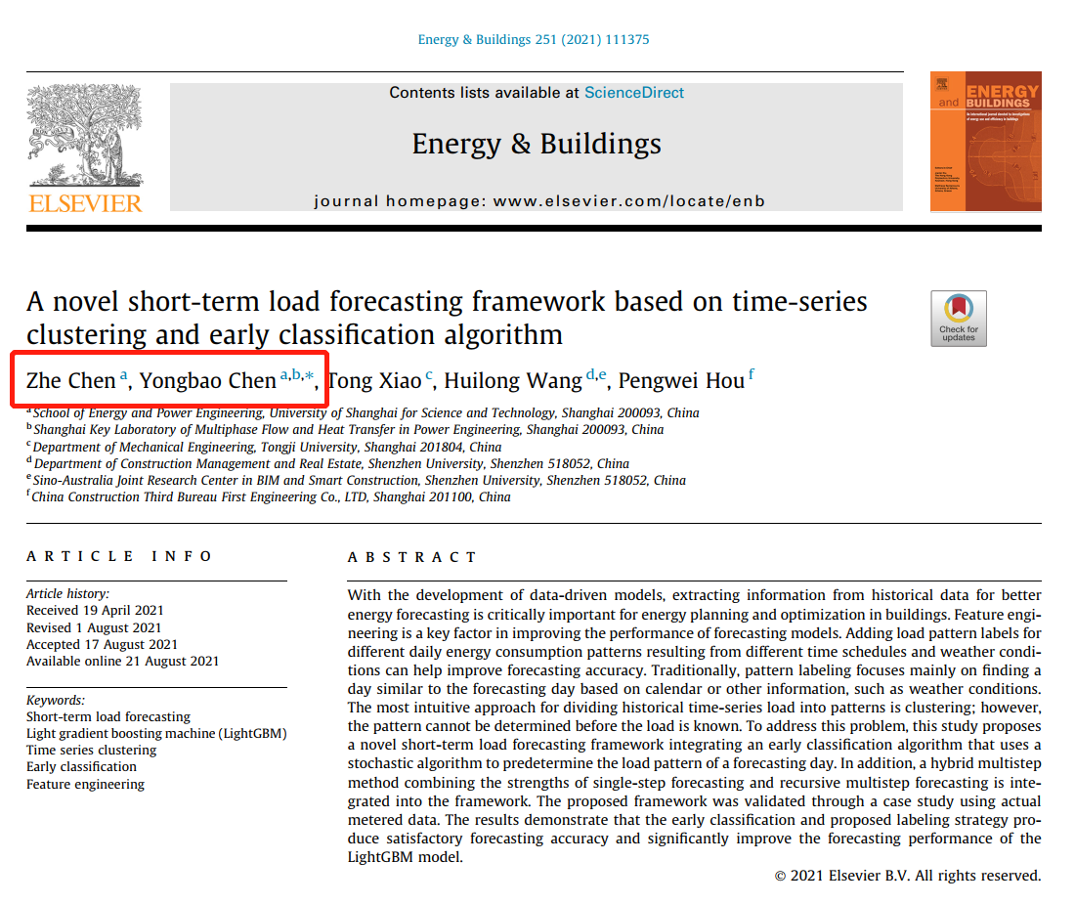
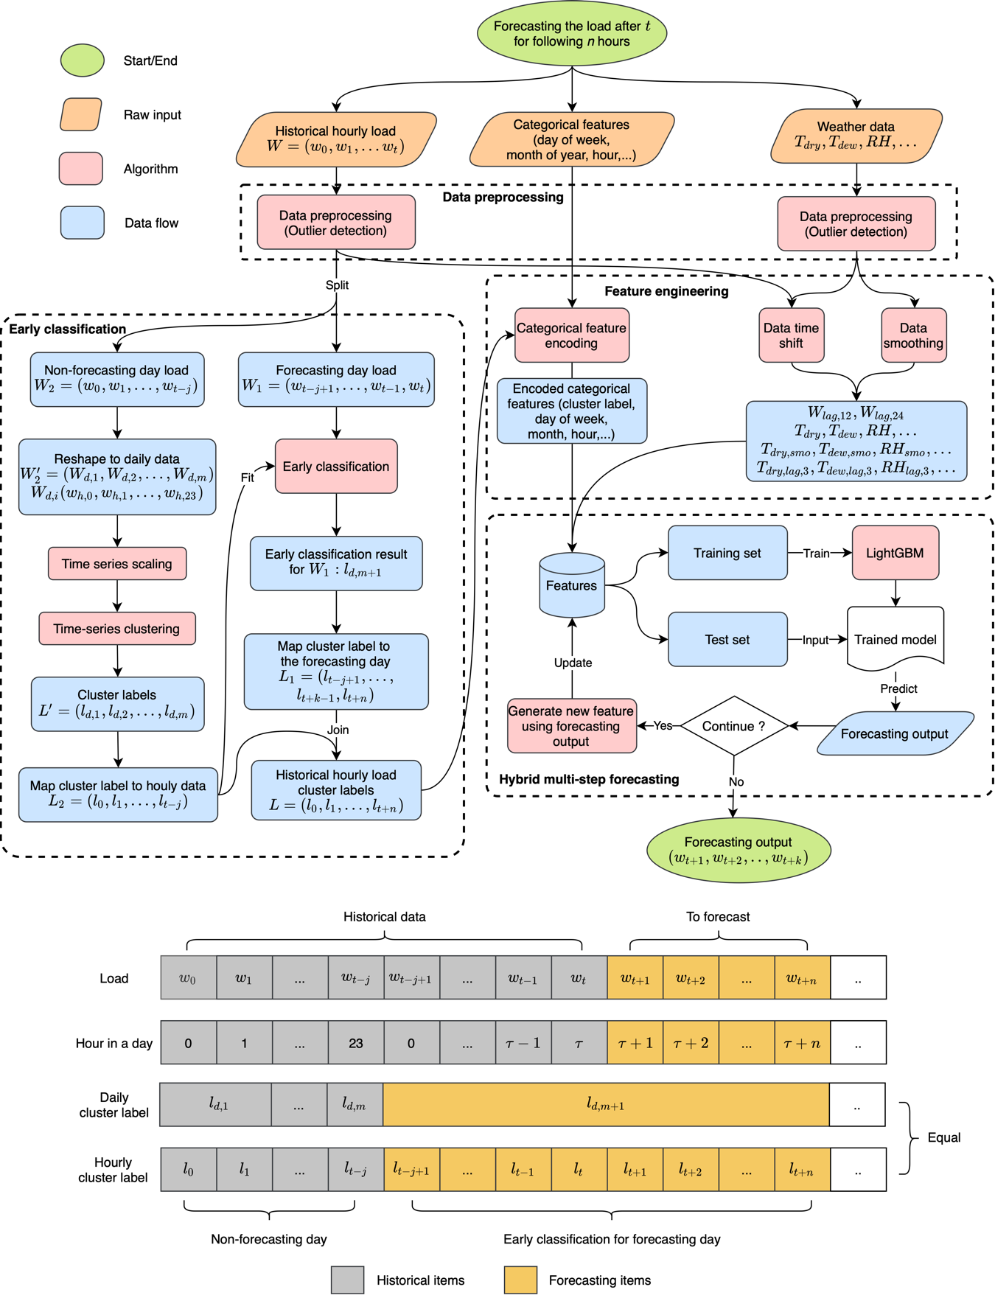
A novel early classification approach
This early classification approach was used to generate new input feature.
Notes:
1、建筑负荷，提前分类，确定预测当天是高还是低
2、利用基础特征，进行clustering

Slide 12
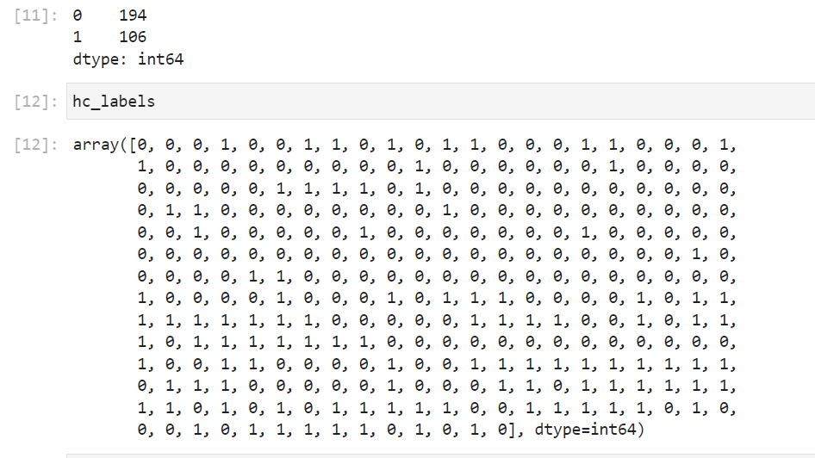
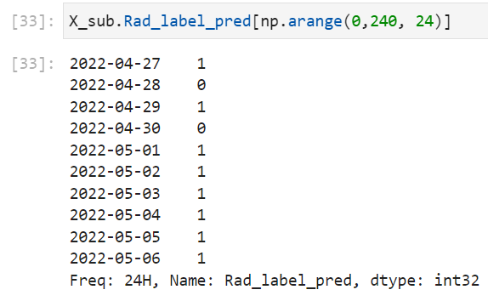
A novel early classification approach
This early classification approach was used to generate new input feature. 0 represents low solar output day, 1 represents high solar output day
Training dataset label results
Test dataset label results

Slide 13
0
3
Results and Discussion

Slide 14
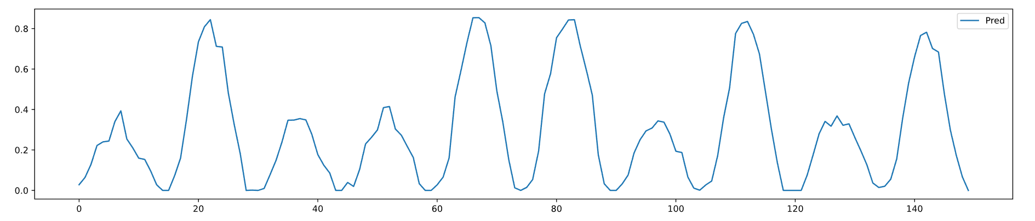
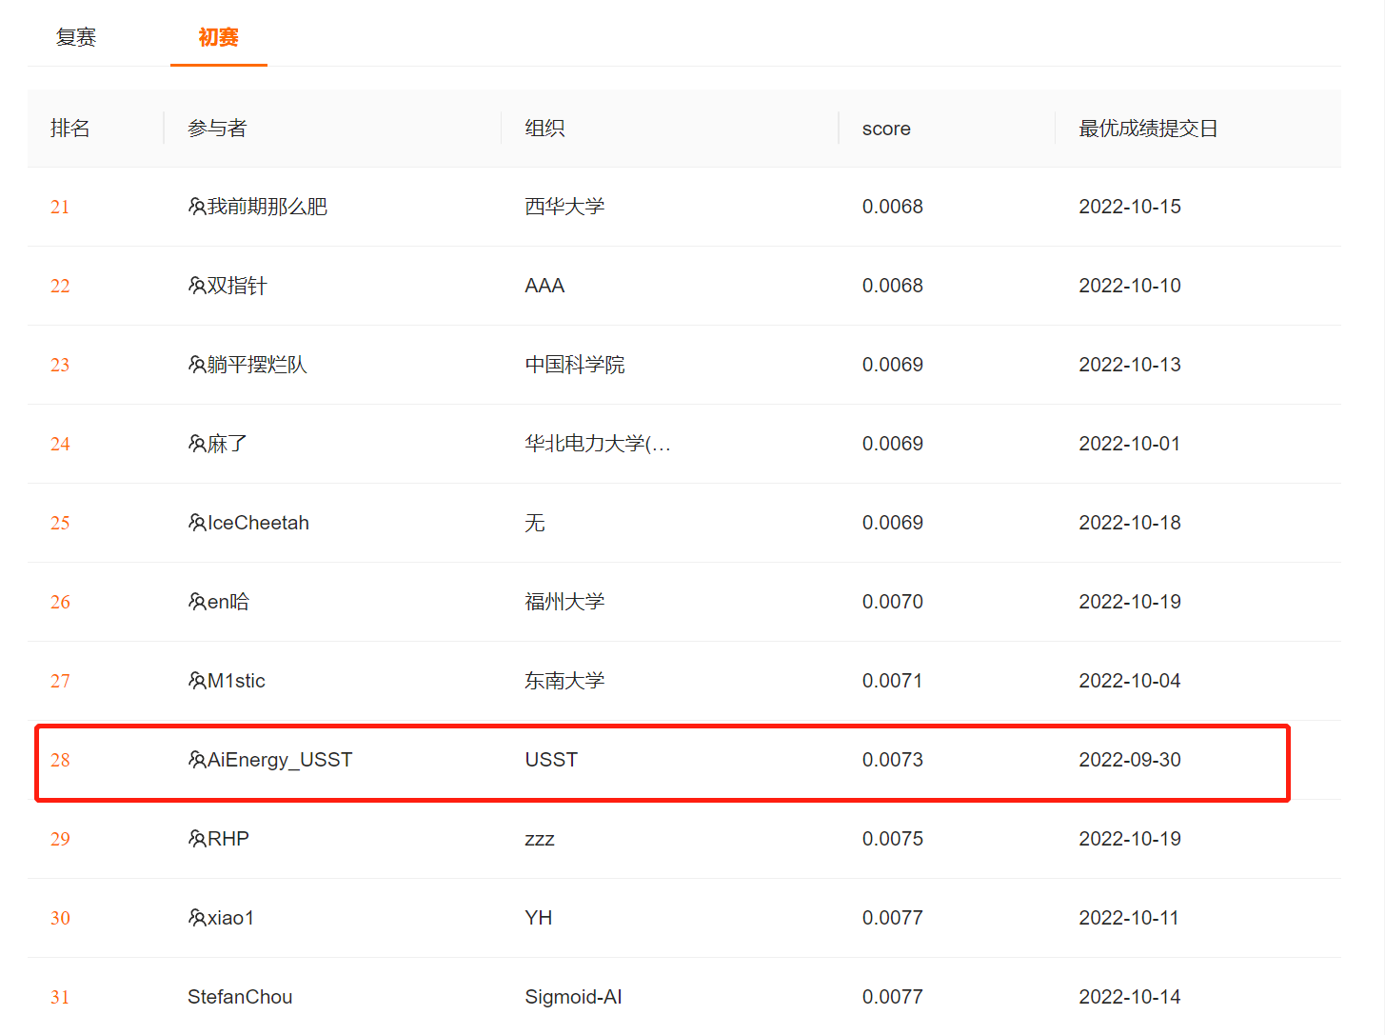
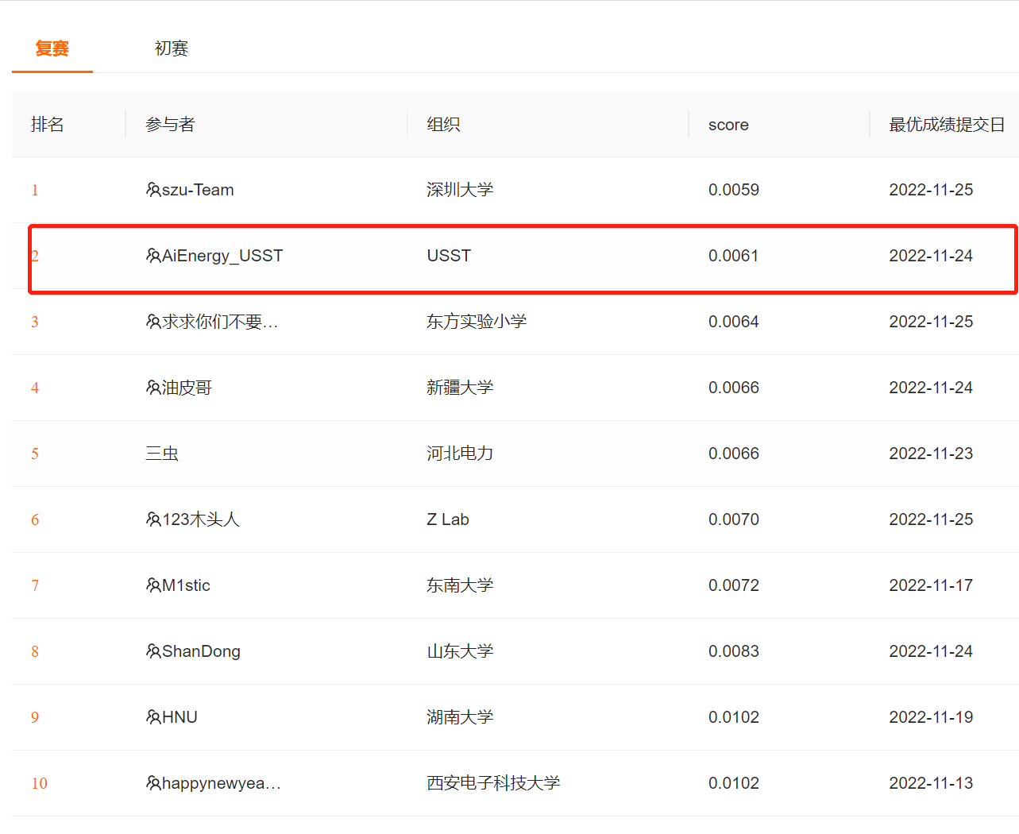
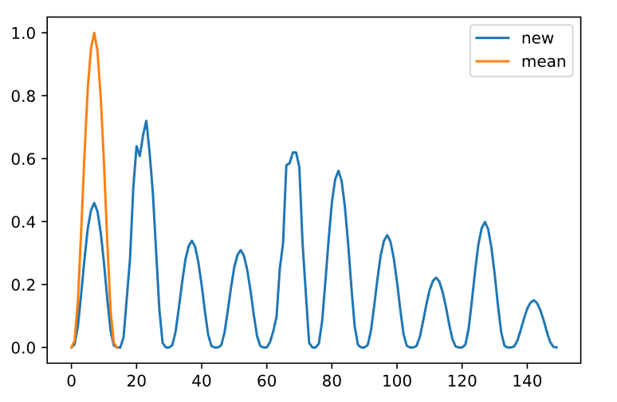
Prediction results
Training dataset results
Ranking 28th
Ranking 2th
Test results

Slide 15
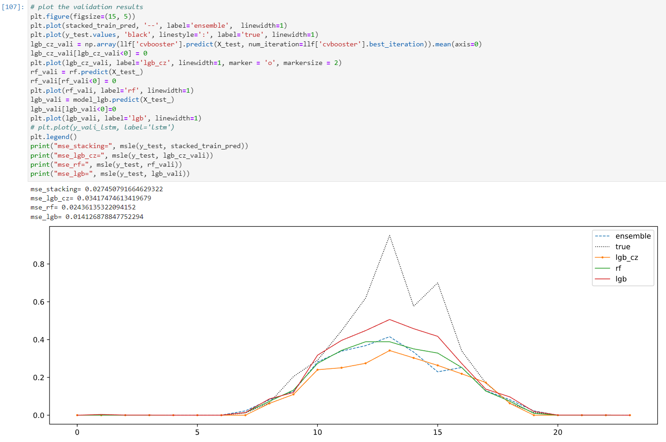
Discussions
MSE of different algorithms:
mse_stacking= 0.027450791664629322
mse_rf= 0.02436135322094152
mse_lgb= 0.014126878847752294
Training dataset MSE results
Training dataset results of one selected day

Slide 16
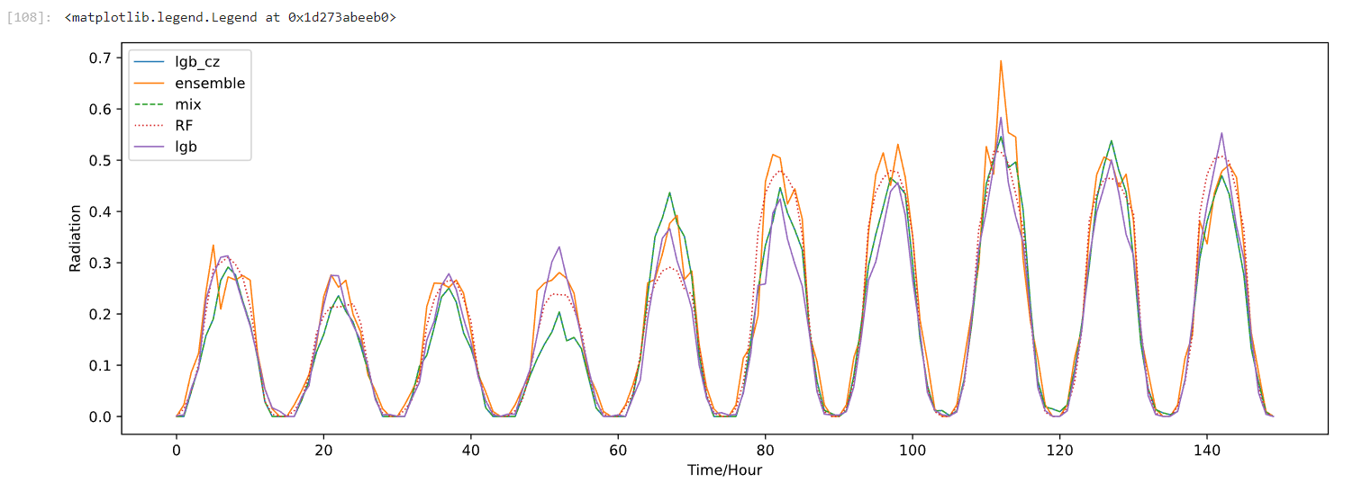
Discussions
Submission prediction results of the preliminary round
We have tried all the results to the online evaluation system, and we found that the lightGBM outperforms other models

Slide 17
0
4
Conclusions and Future Work

Slide 18
Conclusions
LightGBM outperforms the other data-driven models (i.e., SVM, LSTM, RF and its ensemble models) in MSE. The result shows that data processing techniques used in the novel early classification framework including data smoothing, time shift, and label encoding can improve the forecasting performance.
Early classification approach for label encoding can significantly improve short-time load prediction (i.e., ranging from one day to ten days).
Ensemble method is not always well generalization for solar energy prediction, at least in this competition.

Slide 19
Future work
More feature engineering technologies could be investigated, such as time shifting, Variable Transformations, etc.
Instead of 0,1 label encoding, more classification (0, 1, 2, 3…) could be a nice try.
Deep learning algorithms are quite promising, such as GAN, ANN, etc.

Slide 20
THANKS
AiEnergy_USST
Yongbao Chen, chenyongbao@usst.end, 18818262667
Zhe Chen, zhechen1995@gmail.com

